Slide 1
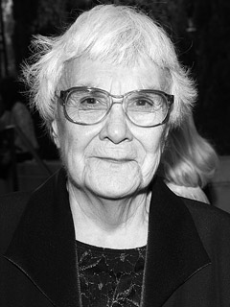
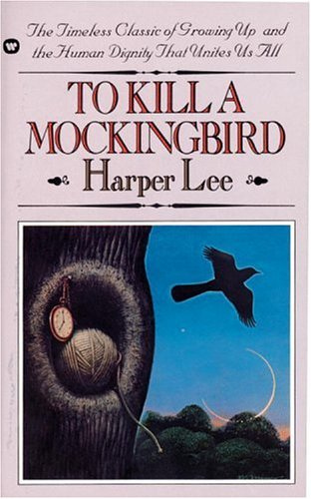
To Kill a Mockingbird Notes Harper Lee Notes Time Period Notes

Slide 2
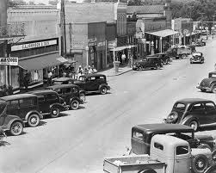
To Kill a Mockingbird
Written in the mid-1950s
Written in New York City
Set in the fictional town of Maycomb, Alabama
Set between the years of 1933 and 1935
Scout Finch is the protagonist.

Slide 3
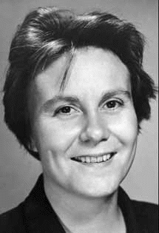
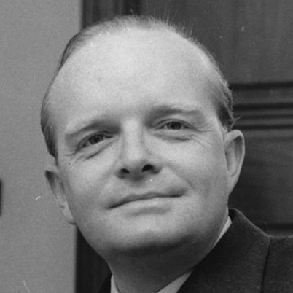
Harper Lee
Full name: Nelle Harper Lee
Born in Monroeville, Alabama
Truman Capote: best friend and next door neighbor to Lee
Lee based the character Dill on Capote
Truman Capote
Harper Lee

Slide 4
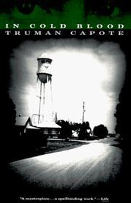
Harper Lee (cont’d)
Lee’s father was a lawyer, providing information on the character Atticus Finch, a lawyer in the novel.
Speculated to be a descendant of Robert E. Lee; other sources are not certain
Based the last name of the family in the novel after her mother’s maiden name: Finch
Lee accompanied Capote to Kansas in 1960 when he was researching for his book In Cold Blood.

Slide 5
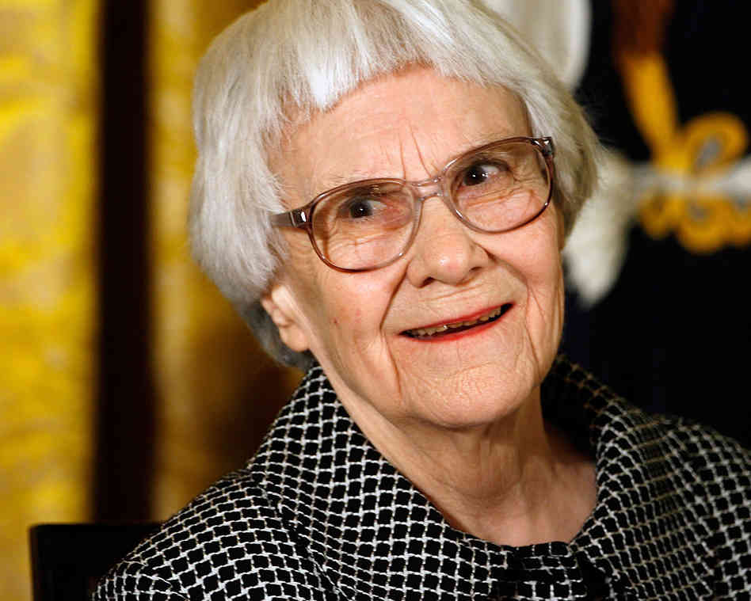
Harper Lee (cont’d)
Lee based the protagonist, Scout, primarily on herself
Broadway composer Michael Brown and his wife supported Lee for a year so she could begin writing
To Kill a Mockingbird was her only novel

Slide 6
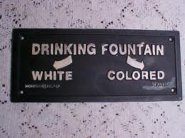
Jim Crow Laws
During the time period in which the book was written, African Americans were by the law free, but the Jim Crow Laws made it difficult for African Americans to find the same equality as whites.

Slide 7
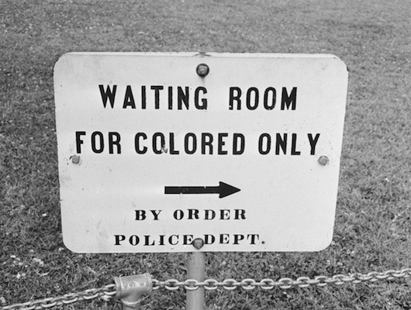
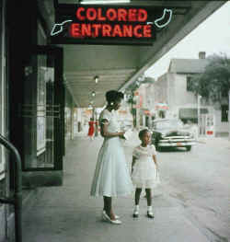
Jim Crow Laws (cont’d)
States imposed legal punishments on those who consorted with others of another race.

Slide 8
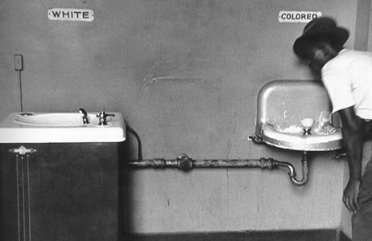
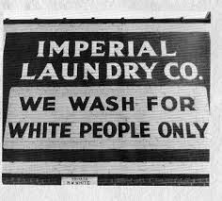
Jim Crow Laws (cont’d)
African Americans and whites could not share public facilities freely: buses, trains, restaurants, pool rooms, public restrooms, and much more.

Slide 9
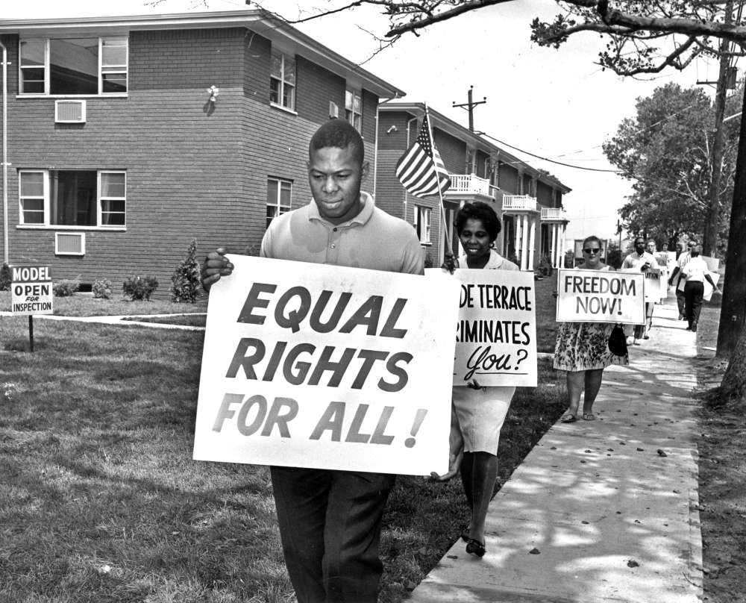
Jim Crow Laws (cont’d)
Meant to keep things separate but equal; however, separate did not mean equal
The racial segregation laws held strong from 1877 until the Civil Rights movement in the 1950s.

Slide 10
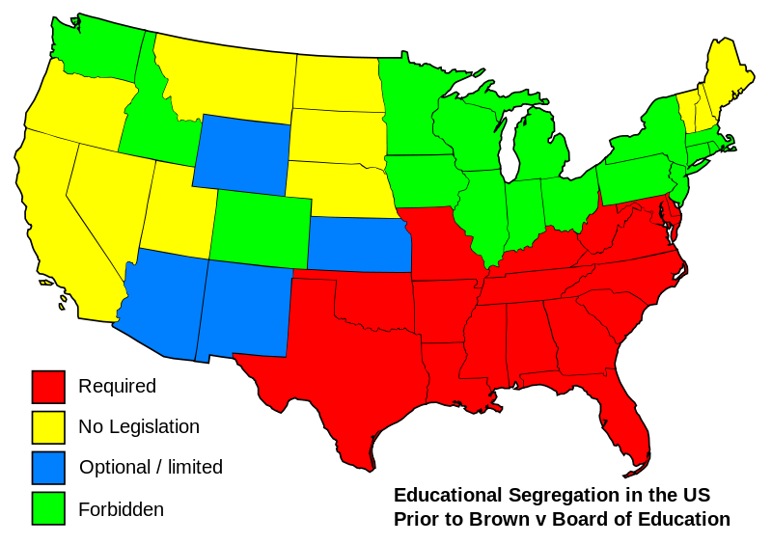
Jim Crow Laws (cont’d)
Some portions of the North might have held to the Jim Crow Laws, but as a whole the South enforced the laws very strictly.

Slide 11
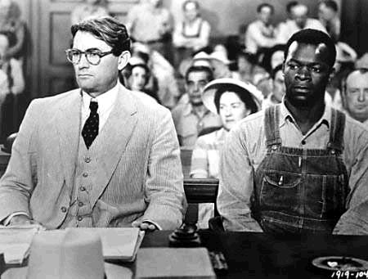
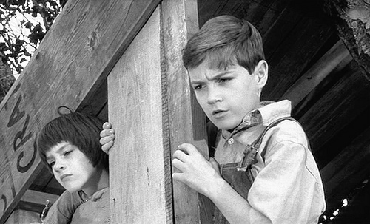
Jim Crow Laws (cont’d)
Characters of To Kill a Mockingbird find themselves caught in a struggle between the Jim Crow Laws and what they know is morally right.

